Slide 1
CSE 417T Introduction to Machine Learning
Lecture 5 Instructor: Chien-Ju (CJ) Ho

Slide 2
Logistics: Homework 1
Due: September 23 (Friday), 2022
http://chienjuho.com/courses/cse417t/hw1.pdf
Two submission links: Report and Code (The links will be up over the weekend)
Report: Answer all questions, including the implementation question
Grades are based on the report
Code: Complete and submit hw1.py for Problem 2
The code will only be used for correctness checking (when in doubts) and plagiarism checking
Reserve time if you never used Gradescope.
Make sure to specify the pages for each problem. You won’t get points otherwise

Slide 3
Logistics: TA Office Hours
Tentative schedule of TA office hours
60 minutes per session; In-person office hours are highlighted in orange
Please follow Piazza for additional information (location, zoom link, etc)
Recommendation: Try to utilize the office hour early (way ahead of deadlines), you are likely to get more of TAs’ time this way
Monday | 9:30am Asher Baraban | 3pm Qihang Zhao
Tuesday | 10am Di Huang | 1pm Andrew Ruttenberg | 4pm Quinn Wai Wong
Wednesday | 1pm Wenxuan Zhu | 3pm William Sepesi | 4:30pm Sylvia Tang
Thursday | 11:30am Yuan Liu | 4pm Elyse Tang | 6:30pm Fankun Zen
Friday | 11am Riggie Kong | 3pm Nan Huang | 5:30pm Weiwei Ma
Sunday | Noon Jonathan Ma | 1:30pm Kenneth Li

Slide 4
Logistics: This Thursday Lecture
A shortened lecture this Thursday (Sep 15)
The lecture starts at 3:10pm
I need to attend a meeting that I cannot skip
As a make-up
I’ll host an additional one-hour office hour next Tuesday
5:30pm – 6:30pm at McKelvey 2010A
My (tentative) regular office hour
5:30pm – 6:30pm Thursday at McKelvey 2010A

Slide 5
Recap

Slide 6


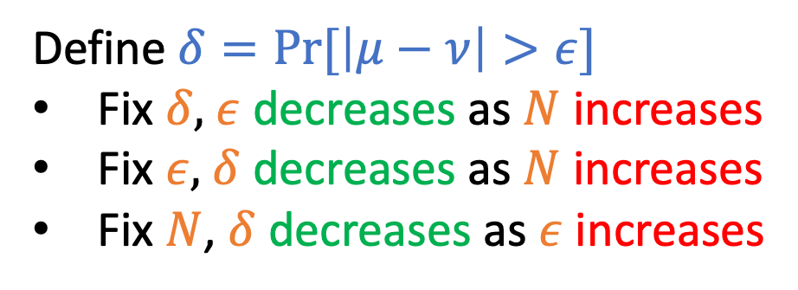
Hoeffding’s Inequality
$$\operatorname{Pr}\left[\left|μ−ν\right|>ε\right]≤2e^{−2ε^{2}N}$$
Draw with replacement
Define $δ=Pr⁡[\left|μ−ν\right|>ε]$
Fix $δ,$ $ε$ decreases as $N$ increases
Fix $ε,$ $δ$ decreases as $N$ increases
Fix $N$, $δ$ decreases as $ε$ increases
N: number of samples
Informal intuitions of notations $N:$ # sample $δ:$ probability of “bad” event
$ε:$ error of estimation

Slide 7
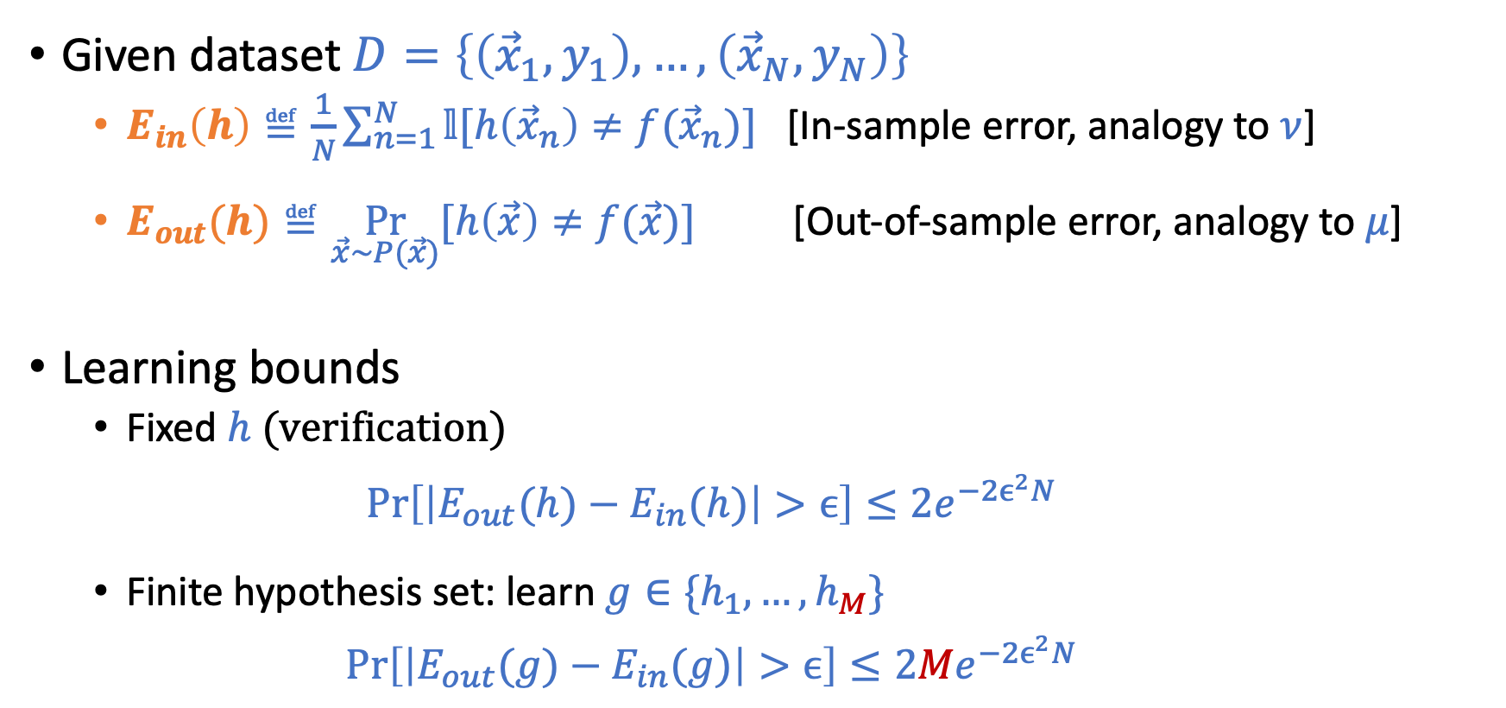
Connection to Learning
Given dataset $D=\left\{\left({\vec{x}}_{1},y_{1}\right),…,\left({\vec{x}}_{N},y_{N}\right)\right\}$
$E_{in}\left(h\right)≝\frac{1}{N}\sum_{n=1}^{N}{𝕝[h\left({\vec{x}}_{n}\right)≠f({\vec{x}}_{n})]}$ [In-sample error, analogy to $ν$]
$E_{out}(h)≝\underset{\vec{x}\sim P(\vec{x})}{Pr}{[h\left(\vec{x}\right)≠f(\vec{x})]}$ [Out-of-sample error, analogy to $μ$]
Learning bounds
Fixed $h$ (verification) $\operatorname{Pr}\left[\left|E_{out}(h)−E_{in}(h)\right|>ϵ\right]≤2e^{−2ϵ^{2}N}$
Finite hypothesis set: learn $g∈\{h_{1},…,h_{M}\}$ $\operatorname{Pr}\left[\left|E_{out}(g)−E_{in}(g)\right|>ϵ\right]≤2{Me}^{−2ϵ^{2}N}$

Slide 8
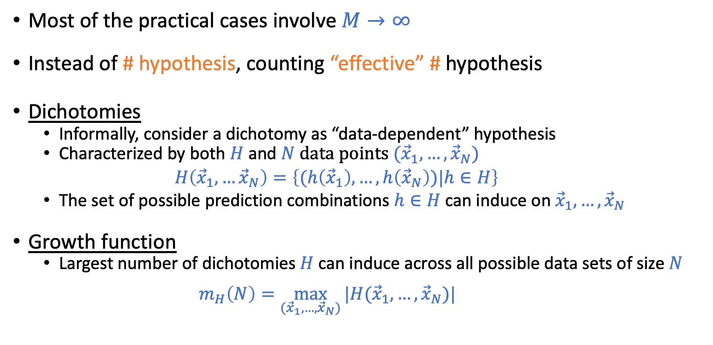

Dealing with Infinite Hypothesis Set: $M→∞$
Most of the practical cases involve $M→∞$
Instead of # hypothesis, counting “effective” # hypothesis
Dichotomies
Informally, consider a dichotomy as “data-dependent” hypothesis
Characterized by both $H$ and $N$ data points $({\vec{x}}_{1},…,{\vec{x}}_{N})$ $H\left({\vec{x}}_{1},…{\vec{x}}_{N}\right)=\left\{(h\left({\vec{x}}_{1}\right),…,h\left({\vec{x}}_{N}\right))|h∈H\right\}$
The set of possible prediction combinations $h∈H$ can induce on${\vec{x}}_{1},…,{\vec{x}}_{N}$
Growth function
Largest number of dichotomies $H$can induce across all possible data sets of size $N$
$m_{H}\left(N\right)=\max_{({\vec{x}}_{1},…,{\vec{x}}_{N})}{|H({\vec{x}}_{1},…,{\vec{x}}_{N})|}$

Slide 9
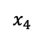
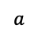
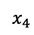
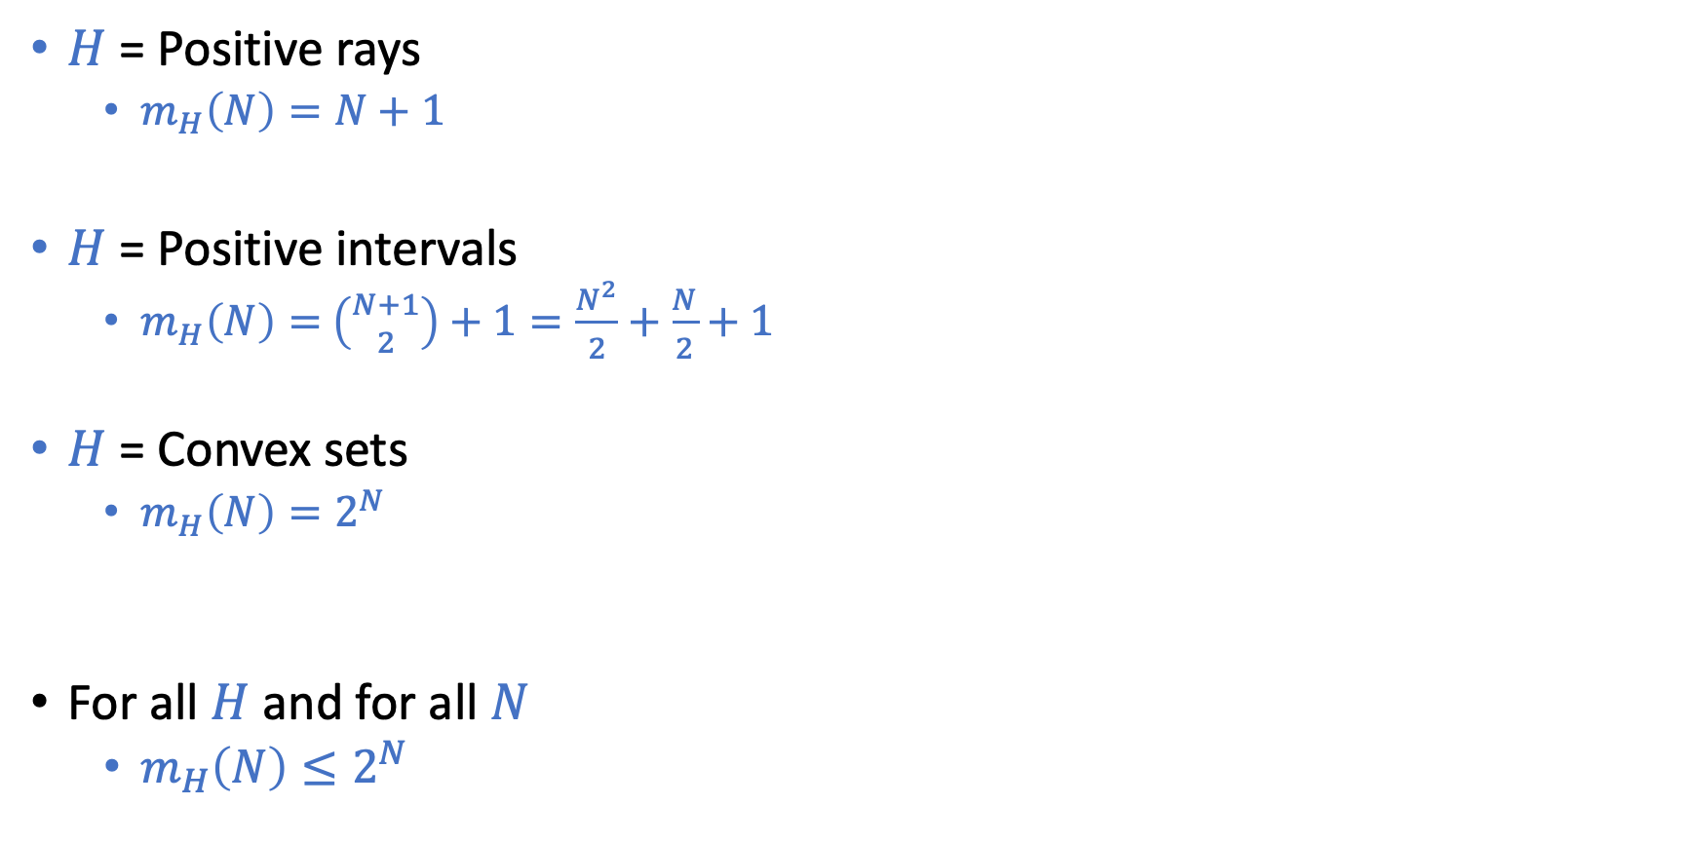
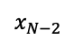
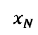
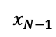
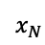
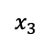
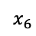
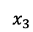
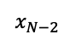
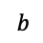
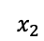
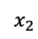
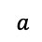
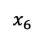
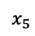
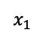
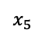
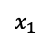
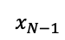
Examples on Growth Functions
Predict -1
Predict +1
$H$ = Positive rays
$m_{H}\left(N\right)=N+1$
$H$ = Positive intervals
$m_{H}\left(N\right)=$ $\left({N+1 \atop 2}\right)+1=\frac{N^{2}}{2}+\frac{N}{2}+1$
$H$ = Convex sets
$m_{H}\left(N\right)=2^{N}$
For all $H$ and for all $N$
$m_{H}\left(N\right)≤2^{N}$
…
$$x_{1}$$
$$x_{2}$$
$$x_{3}$$
$$x_{4}$$
$$x_{5}$$
$$x_{6}$$
$$x_{N−2}$$
$$x_{N−1}$$
$$x_{N}$$
$$a$$
Predict -1
Predict +1
Predict -1
…
$$x_{1}$$
$$x_{2}$$
$$x_{3}$$
$$x_{4}$$
$$x_{5}$$
$$x_{6}$$
$$x_{N−2}$$
$$x_{N−1}$$
$$x_{N}$$
$$a$$
$$b$$
Predcit +1
Predict -1

Slide 10
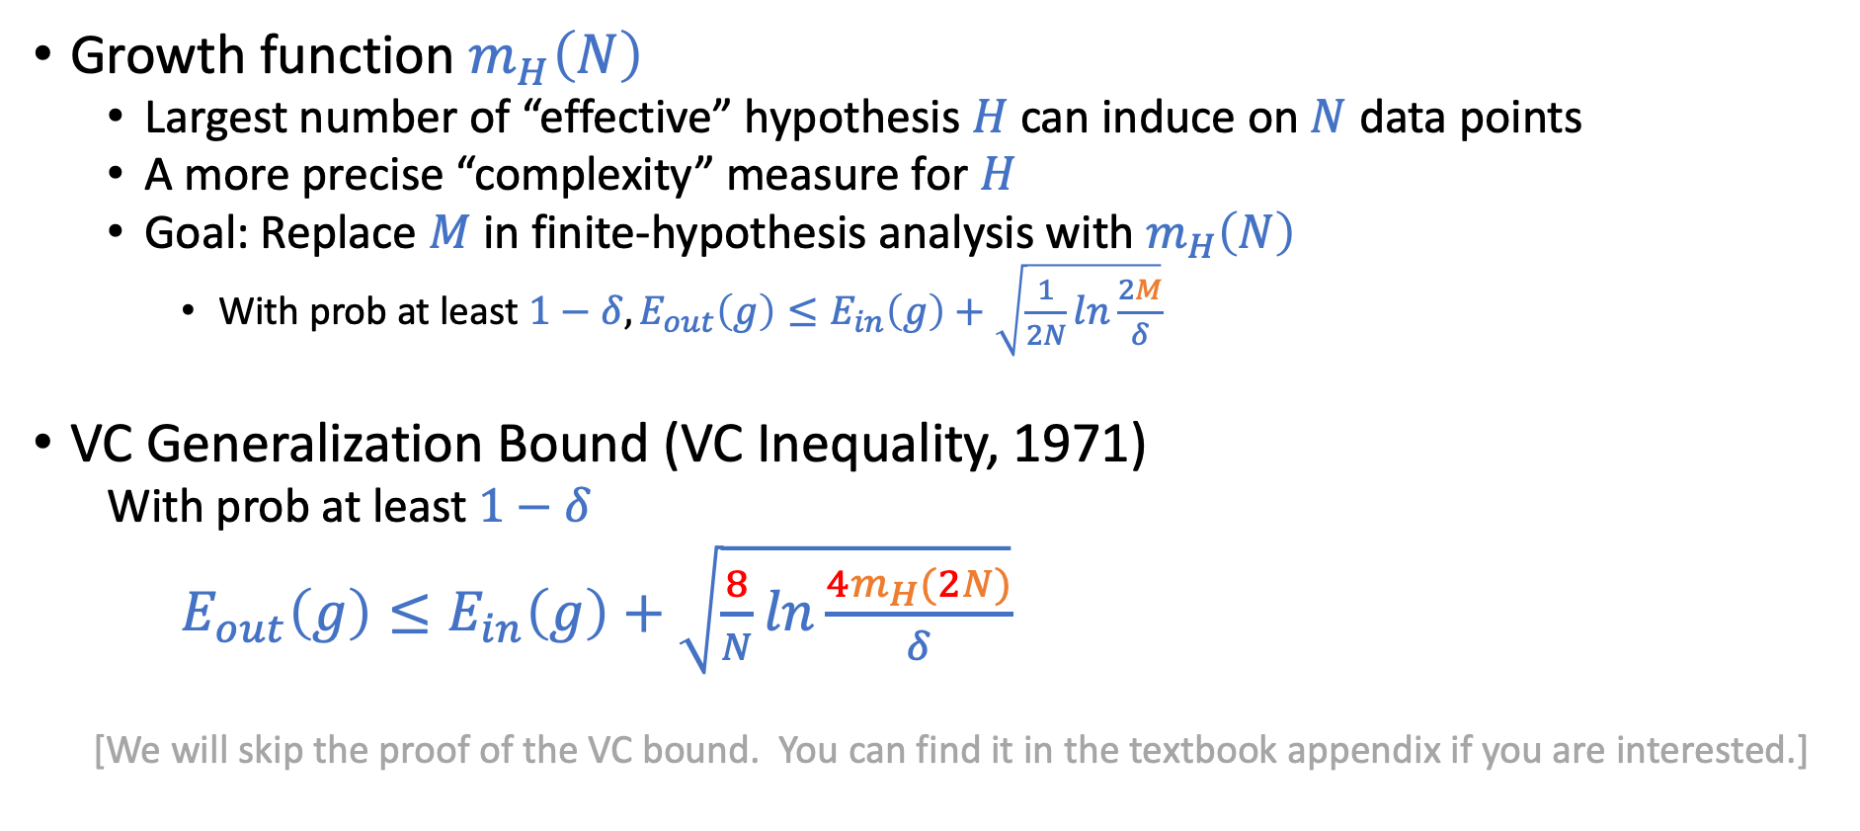
Why Growth Function?
Growth function $m_{H}\left(N\right)$
Largest number of “effective” hypothesis $H$ can induce on $N$ data points
A more precise “complexity” measure for $H$
Goal: Replace $M$ in finite-hypothesis analysis with $m_{H}\left(N\right)$
With prob at least $1−δ, E_{out}\left(g\right)≤E_{in}\left(g\right)+\sqrt{\frac{1}{2N}ln\frac{2M}{δ}}$
VC Generalization Bound (VC Inequality, 1971)
With prob at least $1−δ$
$E_{out}\left(g\right)≤E_{in}\left(g\right)+\sqrt{\frac{8}{N}ln\frac{4m_{H}(2N)}{δ}}$
[We will skip the proof of the VC bound. You can find it in the textbook appendix if you are interested.]

Slide 11
Today’s Lecture
The notes are not intended to be comprehensive. They should be accompanied by lectures and/or textbook.
Let me know if you spot errors.

Slide 12
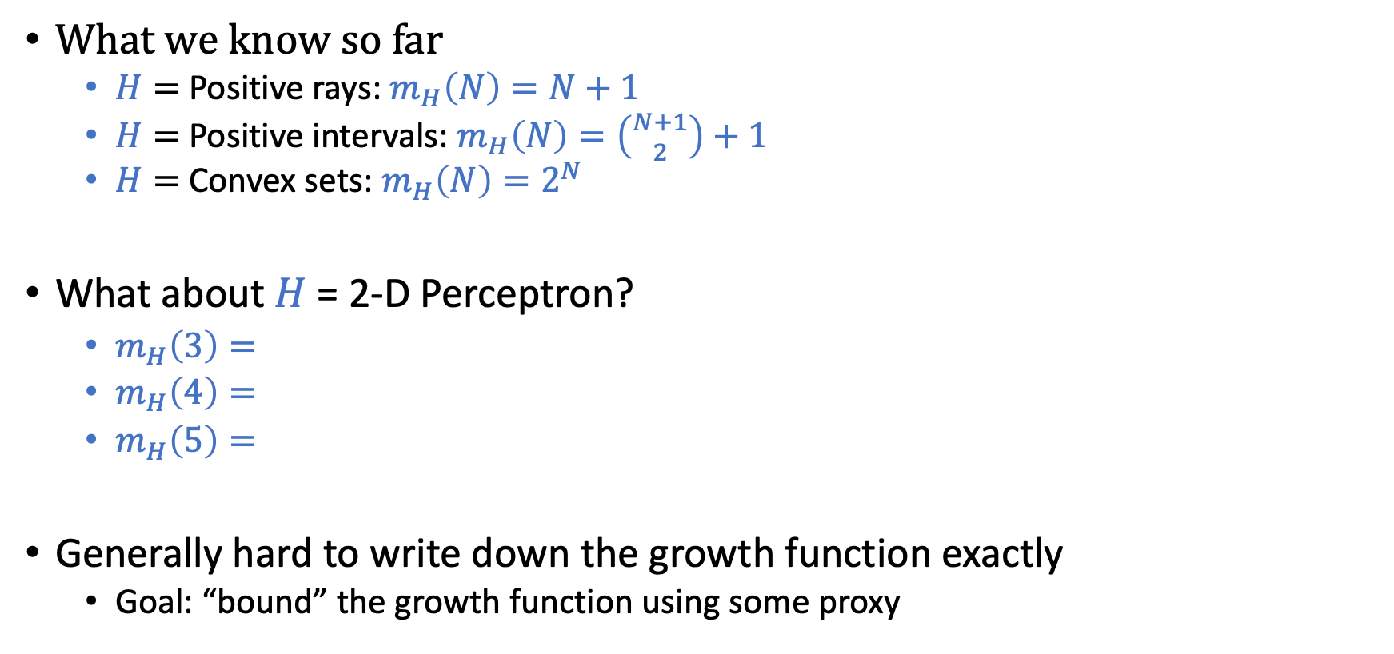
Bounding Growth Function
What we know so far
$H=$ Positive rays: $m_{H}\left(N\right)=N+1$
$H=$ Positive intervals: $m_{H}\left(N\right)=\left({N+1 \atop 2}\right)+1$
$H=$ Convex sets: $m_{H}\left(N\right)=2^{N}$
What about $H$ = 2-D Perceptron?
$m_{H}\left(3\right)=$
$m_{H}\left(4\right)=$
$m_{H}\left(5\right)=$
Generally hard to write down the growth function exactly
Goal: “bound” the growth function using some proxy
8
14
?

Slide 13

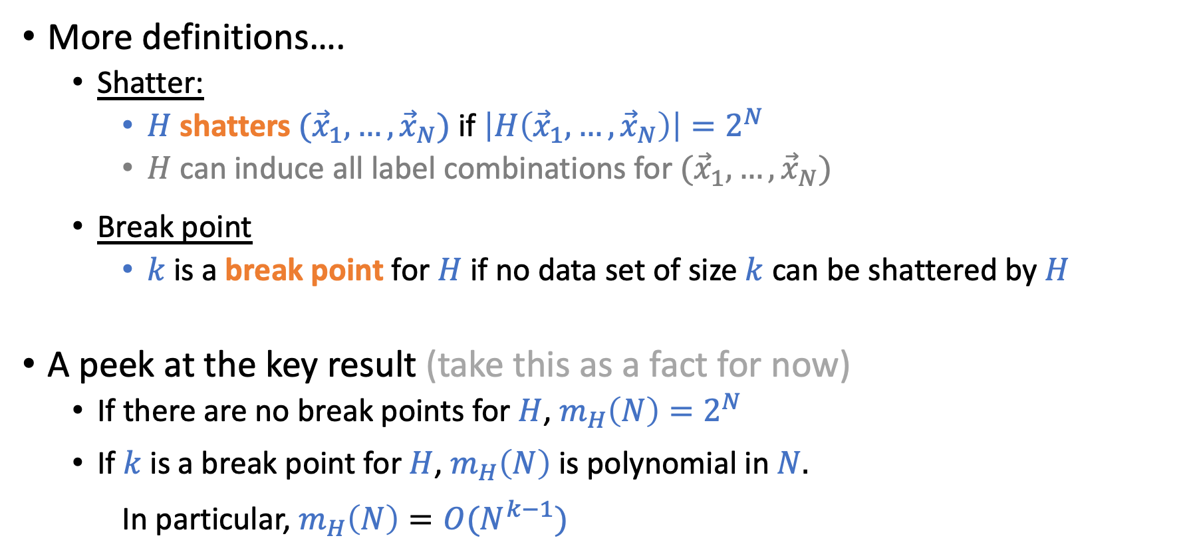
Bounding Growth Function
More definitions….
Shatter:
$H$ shatters $({\vec{x}}_{1},…,{\vec{x}}_{N})$ if $\left|H\left({\vec{x}}_{1},…,{\vec{x}}_{N}\right)\right|=2^{N}$
$H$ can induce all label combinations for $({\vec{x}}_{1},…,{\vec{x}}_{N})$
Break point
$k$ is a break point for $H$ if no data set of size $k$ can be shattered by $H$
A peek at the key result (take this as a fact for now)
If there are no break points for $H$, $m_{H}\left(N\right)=2^{N}$
If $k$ is a break point for $H$, $m_{H}\left(N\right)$ is polynomial in $N.$ In particular, $m_{H}\left(N\right)=O(N^{k−1})$
A bit more accurately:
$m_{H}\left(N\right)≤\sum_{i=1}^{k−1}{\left({N \atop i}\right)}$, or
$m_{H}\left(N\right)≤N^{k−1}+1$

Slide 14
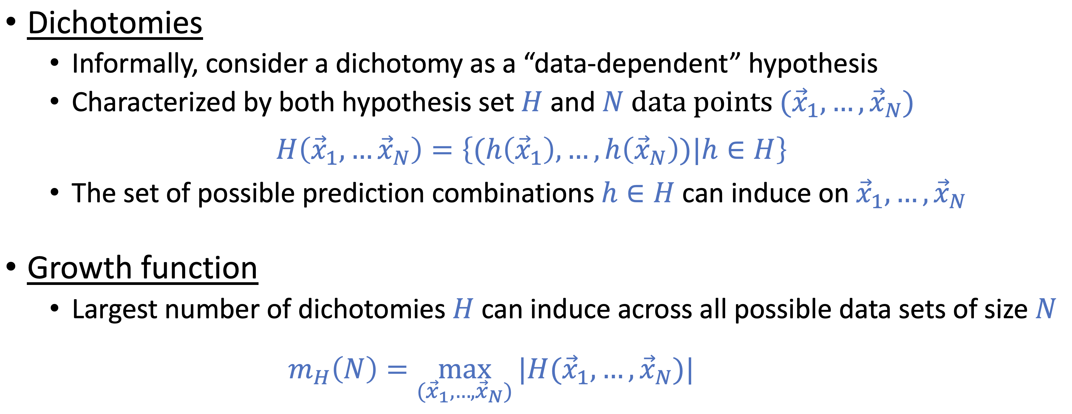

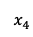
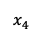
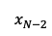
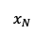
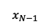
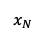
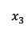
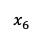
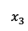
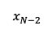
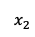
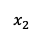
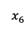
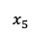
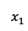
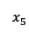
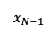
Practice
What are the break points for
1. Positive Rays
2. Positive Intervals
3. Convex Sets
4. 2-D Perceptron
Predict -1
Predict +1
Predict -1
Predict +1
Predict -1
Predcit +1
$$x_{1}$$
$$x_{2}$$
$$x_{3}$$
$$x_{4}$$
$$x_{5}$$
$$x_{6}$$
…
$$x_{N−2}$$
$$x_{N−1}$$
$$x_{N}$$
…
Predict -1
$$x_{1}$$
$$x_{2}$$
$$x_{3}$$
$$x_{4}$$
$$x_{5}$$
$$x_{6}$$
$$x_{N−2}$$
$$x_{N−1}$$
$$x_{N}$$
$$a$$
$$a$$
$$b$$

Slide 15
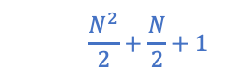

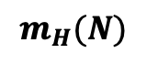
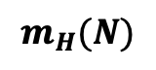
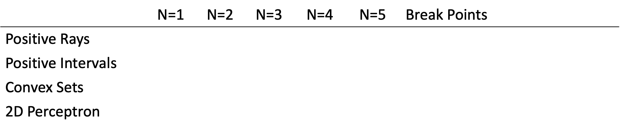

Practice
$$m_{H}(N)$$
$$m_{H}(N)$$
 | N=1 | N=2 | N=3 | N=4 | N=5 | Break Points | VC Dimension
Positive Rays | 2 | 3 | 4 | 5 | 6 | $$k=2,3,4,…$$ | 1
Positive Intervals | 2 | 4 | 7 | 11 | 16 | $$k=3,4,5,…$$ | 2
Convex Sets | 2 | 4 | 8 | 16 | 32 | None | $$∞$$
2D Perceptron | 2 | 4 | 8 | 14 | ? | $$k=4,5,6,…$$ | 3
$$N+1$$
$$\frac{N^{2}}{2}+\frac{N}{2}+1$$
$$2^{N}$$

Slide 16

Practice
$$m_{H}(N)$$
$$m_{H}(N)$$
 | N=1 | N=2 | N=3 | N=4 | N=5 | Break Points | VC Dimension
Positive Rays | 2 | 3 | 4 | 5 | 6 | $$k=2,3,4,…$$ | 1
Positive Intervals |  |  |  |  |  |  | 2
Convex Sets |  |  |  |  |  |  | $$∞$$
2D Perceptron |  |  |  |  |  |  | 3
$$N+1$$
$$\frac{N^{2}}{2}+\frac{N}{2}+1$$
$$2^{N}$$

Slide 17


Practice
$$m_{H}(N)$$
$$m_{H}(N)$$
 | N=1 | N=2 | N=3 | N=4 | N=5 | Break Points | VC Dimension
Positive Rays | 2 | 3 | 4 | 5 | 6 | $$k=2,3,4,…$$ | 1
Positive Intervals | 2 | 4 | 7 | 11 | 16 | $$k=3,4,5,…$$ | 2
Convex Sets | 2 | 4 | 8 | 16 | 32 | None | $$∞$$
2D Perceptron | 2 | 4 | 8 | 14 | ? | $$k=4,5,6,…$$ | 3
$$N+1$$
$$\frac{N^{2}}{2}+\frac{N}{2}+1$$
$$2^{N}$$

Slide 18

Why Break Points?
Theorem statement (Again, take it as a fact for now)
If there is no break point for $H$, then $m_{H}\left(N\right)=2^{N}$ for all $N.$
If $k$ is a break point for $H$, i.e., if $m_{H}\left(k\right)<2^{k}$ for some value $k,$ then
$m_{H}\left(N\right)≤\sum_{i=0}^{k−1}{\left({N \atop i}\right)}$
The above theorem can be rephrased below:
If there is no break point for $H$, then $m_{H}\left(N\right)=2^{N}$ for all $N.$
If $k$ is a break point for $H$, the following statements are true
$m_{H}\left(N\right)≤N^{k−1}+1$ [Can be proven using induction. See LFD Problem 2.5]
$m_{H}\left(N\right)=O(N^{k−1})$
$m_{H}\left(N\right)$ is polynomial in $N$
We can “bound” the growth function without knowing it exactly.
Find break point!

Slide 19

Recall the VC Generalization Bound
VC Generalization Bound
With prob $1−δ$
$E_{out}\left(g\right)≤E_{in}\left(g\right)+\sqrt{\frac{8}{N}ln\frac{4m_{H}(2N)}{δ}}$
In the following discussion, we treat $δ$ as a constant [i.e., with high probability, the following is true]
$E_{out}\left(g\right)≤E_{in}\left(g\right)+O\left(\sqrt{\frac{1}{N}\ln{m_{H}(N)}}\right)$
[For example, we can set $δ$ to be a small constant, say 0.01. Then every time we wrote the above inequality, we mean that it is true with probability at least 99%.]

Slide 20


Applying Break Points in VC Bound
If there are no break point ($m_{H}\left(N\right)=2^{N}$)
$E_{out}\left(g\right)≤E_{in}\left(g\right)+O(1)$ (This implies that we can’t infer $E_{out}$ from $E_{in}$ even when $N→∞$)
If $k$ is a break point for $H,$ i.e., $m_{H}\left(N\right)=O(N^{k−1})$
$E_{out}\left(g\right)≤E_{in}\left(g\right)+O\left(\sqrt{(k−1)\frac{ln⁡N}{N}}\right)$
VC Bound: $E_{out}\left(g\right)≤E_{in}\left(g\right)+O\left(\sqrt{\frac{1}{N}\ln{m_{H}(N)}}\right)$

Slide 21


$H$ is Either Good or Bad
The growth function of $H$ is either one of the two
Without break points, $m_{H}\left(N\right)=2^{N}$
With some break point, $m_{H}\left(N\right)$ is polynomial in $N$ (it can be bounded more tightly using the theorem)
There is nothing in between!
Bad hypothesis set $E_{out}\left(g\right)≤E_{in}\left(g\right)+O(1)$
Good hypothesis set $m_{H}\left(N\right)=O(N^{k−1})$
$E_{out}\left(g\right)≤E_{in}\left(g\right)+O\left(\sqrt{(k−1)\frac{ln⁡N}{N}}\right)$

Slide 22



VC Dimension
VC Dimension of $H:$ $d_{vc}\left(H\right)$ or $d_{vc}$
The VC dimension of $H$ is the largest $N$ such that $m_{H}\left(N\right)=2^{N}.$
$d_{vc}\left(H\right)=∞$ if $m_{H}\left(N\right)=2^{N}$ for all $N$.
Or, let $k^{∗}$ be the smallest break point for $H$, the VC dimension of $H$ is $k^{∗}−1$
$$m_{H}(N)$$
 | N=1 | N=2 | N=3 | N=4 | N=5 | Break Points | VC Dimension
Positive Rays | 2 | 3 | 4 | 5 | 6 | $$k=2,3,4,…$$ | 1
Positive Intervals | 2 | 4 | 7 | 11 | 16 | $$k=3,4,5,…$$ | 2
Convex Sets | 2 | 4 | 8 | 16 | 32 | None | $$∞$$
2D Perceptron | 2 | 4 | 8 | 14 | ? | $$k=4,5,6,…$$ | 3

Slide 23

VC Dimension
VC Dimension of $H:$ $d_{vc}\left(H\right)$ or $d_{vc}$
The VC dimension of $H$ is the largest $N$ such that $m_{H}\left(N\right)=2^{N}.$
$d_{vc}\left(H\right)=∞$ if $m_{H}\left(N\right)=2^{N}$ for all $N$.
Or, let $k^{∗}$ be the smallest break point for $H$, the VC dimension of $H$ is $k^{∗}−1$
$$m_{H}(N)$$
 | N=1 | N=2 | N=3 | N=4 | N=5 | Break Points | VC Dimension
Positive Rays | 2 | 3 | 4 | 5 | 6 | $$k=2,3,4,…$$ | 1
Positive Intervals | 2 | 4 | 7 | 11 | 16 | $$k=3,4,5,…$$ | 2
Convex Sets | 2 | 4 | 8 | 16 | 32 | None | $$∞$$
2D Perceptron | 2 | 4 | 8 | 14 | ? | $$k=4,5,6,…$$ | 3

Slide 24



VC Dimension
VC Dimension of $H:$ $d_{vc}\left(H\right)$ or $d_{vc}$
The VC dimension of $H$ is the largest $N$ such that $m_{H}\left(N\right)=2^{N}.$
$d_{vc}\left(H\right)=∞$ if $m_{H}\left(N\right)=2^{N}$ for all $N$.
Or, let $k^{∗}$ be the smallest break point for $H$, the VC dimension of $H$ is $k^{∗}−1$
Plug the definition into VC Generalization Bound
$$E_{out}\left(g\right)≤E_{in}\left(g\right)+O\left(\sqrt{d_{VC}\frac{\ln{N}}{N}}\right)$$

Slide 25
Discussion on the VC Theory

Slide 27


Discussion on the VC Theory
VC Bound
Built on top of the i.i.d. data assumption
The bound is “loose”
Depends only on $H$ and $N$
The analysis is loose in many places
However, it qualitatively characterizes the practice reasonably well
(the bound is roughly equally loose for every $H$)
$$E_{out}\left(g\right)≤E_{in}\left(g\right)+O\left(\sqrt{d_{VC}\frac{\ln{N}}{N}}\right)$$

Slide 28


$$E_{out}\left(g\right)≤E_{in}\left(g\right)+O\left(\sqrt{d_{VC}\frac{\ln{N}}{N}}\right)$$
Goal of learning: Minimize $E_{out}\left(g\right)$
How to achieve that
Minimize $E_{in}\left(g\right)$
Choose a hypothesis set with large $d_{VC}$ (complex hypothesis likely fit data better)
Minimize generalization error
Choose a hypothesis with small $d_{VC}$
Have a lot of data points to train on ($N$ is large)
Think about the high-level tradeoff of choosing $d_{VC}$ and its dependency on $N$

Slide 29


Discussion on the VC Theory
It establishes the feasibility of learning for infinite hypothesis set
It provides nice intuitions on what’s happening underneath ML
A single parameter to characterize complexity of $H$
$$E_{out}\left(g\right)≤E_{in}\left(g\right)+O\left(\sqrt{d_{VC}\frac{\ln{N}}{N}}\right)$$

Slide 30

Discussion on the VC Theory
It establishes the feasibility of learning for infinite hypothesis set.
It provides nice intuitions on what’s happening underneath ML.
A single parameter to characterize complexity of $H$
$$E_{out}\left(g\right)≤E_{in}\left(g\right)+O\left(\sqrt{d_{VC}\frac{\ln{N}}{N}}\right)$$

Slide 31


Sample Complexity
Sample complexity:
Analogy to time/space complexity
How many data points do we need to achieve generalization error less than $ε$ with prob $1−δ$?
Recall the (full) VC Bound: With prob at least $1−δ, E_{out}\left(g\right)≤E_{in}\left(g\right)+\sqrt{\frac{8}{N}ln\frac{4{(\left(2N\right)}^{d_{vc}}+1)}{δ}}$
How to determine the sample complexity?
Set $\sqrt{\frac{8}{N}ln\frac{4{(\left(2N\right)}^{d_{vc}}+1)}{δ}}≤ε$
We get $N≥$ $\frac{8}{ε^{2}}\ln\left(\frac{4\left({1+\left(2N\right)}^{d_{VC}}\right)}{δ}\right)$
$N∝1/ε^{2}$
$N=O(d_{vc}\ln{N})$
Empirically, people roughly $N∝d_{vc}$

Slide 32

Test Set
Goal of learning: Minimize $E_{out}(g)$
Can we estimate $E_{out}$ directly?
Reserve a test set ($D_{test}$) before learning
Ensure $D_{test}$ is not used at all in any way for learning
For $D_{test}$, $g$ is a “fixed” hypothesis and standard Hoeffding’s inequality is valid
Let $E_{test}(g)$ be the error in the test set
$P\left\{\left|E_{test}\left(g\right)−E_{out}\left(g\right)\right|>ε\right\}≤2e^{−2ε^{2}N_{test}}$ where $N_{test}=\left|D_{test}\right|$

Slide 33

Test Set
Test set is great: we can obtain an unbiased estimate of $E_{out}$
At what cost?
We have a finite amount of data
Data points in test set cannot be involved in learning at all
More points in test set
Better estimate of $E_{out}$
Less data points in training set -> often leads to worse learned hypothesis
Practical rule of thumb (i.e., a common heuristic, not really a gold rule)
80% for training, 20% for testing

Slide 34
Proof: Bounding Growth Functions

Slide 35

Recall: Theorem in Bounding Growth Function
Theorem statement:
If there is no break point for $H$, then $m_{H}\left(N\right)=2^{N}$ for all $N.$
If $k$ is a break point for $H$, i.e., if $m_{H}\left(k\right)<2^{k}$ for some value $k,$ then
$m_{H}\left(N\right)≤\sum_{i=0}^{k−1}{\left({N \atop i}\right)}$
You were asked to take this as a fact
Will provide proof sketch now

Slide 36
Proof Sketch
[See LFD Section 2.1.2 for the formal proof]
[Safe to Skip] (This proof won’t appear in exams/homework)

Slide 37

Key Intuitions
[Safe to Skip]
When there exist a break point $k$
No datasets of size $k$ can be shattered
It also imposes strong constraints on dataset of size $k^{′}>k$
No subset of data with size $k$ can be shattered
This leads to the bound $m_{H}\left(N\right)=O(N^{k−1})$

Slide 38

Proof Intuitions
[Safe to Skip]
Max # dichotomies you can list on 2 points when no 2 points can be shattered
$${\vec{x}}_{1}$$ | $${\vec{x}}_{2}$$
+1 | +1
+1 | -1
-1 | +1

Slide 39

Proof Intuitions
[Safe to Skip]
Max # dichotomies you can list on 4 points when no 2 points can be shattered
$${\vec{x}}_{1}$$ | $${\vec{x}}_{2}$$ | $${\vec{x}}_{3}$$ | $${\vec{x}}_{4}$$
+1 | +1 | +1 | +1
+1 | +1 | +1 | -1
+1 | +1 | -1 | +1
+1 | -1 | +1 | +1
-1 | +1 | +1 | +1
Can you add an additional dichotomy?

Slide 40



Proof Intuitions
[Safe to Skip]
How “no 2 points are shattered” impacts the scenario with 4 points?
$${\vec{x}}_{1}$$ | $${\vec{x}}_{2}$$ | $${\vec{x}}_{3}$$ | $${\vec{x}}_{4}$$
+1 | +1 | +1 | +1
+1 | +1 | +1 | -1
+1 | +1 | -1 | +1
+1 | -1 | +1 | +1
-1 | +1 | +1 | +1
(${\vec{x}}_{1},{\vec{x}}_{2},{\vec{x}}_{3}$) appear twice, with different ${\vec{x}}_{4}$
No 1 point is shattered
(${\vec{x}}_{1},{\vec{x}}_{2},{\vec{x}}_{3}$) appear once (including one in each of the pair above)
No 2 points are shattered

Slide 41




Proof Intuitions
[Safe to Skip]
Max # dichotomies you can list on 4 points when no 2 points can be shattered
No 1 point is shattered
$B\left(N,k\right)$: max # dichotomies on $N$ points when no $k$ points are shattered
$${\vec{x}}_{1}$$ | $${\vec{x}}_{2}$$ | $${\vec{x}}_{3}$$ | $${\vec{x}}_{4}$$
+1 | +1 | +1 | +1
+1 | +1 | +1 | -1
+1 | +1 | -1 | +1
+1 | -1 | +1 | +1
-1 | +1 | +1 | +1
A recursive definition: $$B\left(N,k\right)≤B\left(N−1,k\right)+B(N−1,k−1)$$
Sauer’s Lemma: $B\left(N,k\right)≤\sum_{i=0}^{k−1}{\left({N \atop i}\right)}$
Can be proved by induction
$B\left(N,k\right)≤\sum_{i=0}^{k−1}{\left({N \atop i}\right)}$is the bound of $m_{H}(N)$ for $H$ with break point $k$
No 2 points are shattered

Slide 42


Summary: Bounding Growth Functions
Theorem statement:
If there is no break point for $H$, then $m_{H}\left(N\right)=2^{N}$ for all $N.$
If $k$ is a break point for $H$, i.e., if $m_{H}\left(k\right)<2^{k}$ for some value $k,$ then
$m_{H}\left(N\right)≤\sum_{i=0}^{k−1}{\left({N \atop i}\right)}$
Rephrase the 2nd statement of the above theorem
If $k$ is a break point for $H$, the following statements are true
$m_{H}\left(N\right)≤N^{k−1}+1$ [Can be proven using induction from above. See LFD Problem 2.5]
$m_{H}\left(N\right)=O(N^{k−1})$
$m_{H}\left(N\right)$ is polynomial in $N$
If $d_{vc}$ is the VC dimension of $H$, then
$m_{H}\left(N\right)≤$ $\sum_{i=0}^{d_{vc}}{\left({N \atop i}\right)}$
$m_{H}\left(N\right)≤N^{d_{vc}}+1$
$m_{H}\left(N\right)=O(N^{d_{vc}})$
If $d_{vc}$ is the VC dimension of $H$, $d_{vc}+1$ is a break point for $H$

Slide 43

Summary: Vapnik–Chervonenkis (VC) Bound
VC Generalization Bound
With prob at least $1−δ$
$E_{out}\left(g\right)≤E_{in}\left(g\right)+\sqrt{\frac{8}{N}ln\frac{4m_{H}(2N)}{δ}}$
Let $d_{vc}$ be the VC dimension of $H$, we have $m_{H}\left(N\right)≤N^{d_{vc}}+1.$
With prob at least $1−δ$
$E_{out}\left(g\right)≤E_{in}\left(g\right)+\sqrt{\frac{8}{N}ln\frac{4{(\left(2N\right)}^{d_{vc}}+1)}{δ}}$
If we treat $δ$ as a constant, then we can say, with high probability
$E_{out}\left(g\right)≤E_{in}\left(g\right)+O\left(\sqrt{d_{vc}\frac{\ln{N}}{N}}\right)$

Slide 44


Bounding Growth Function using Break Points
Theorem statement:
If there is no break point for $H$, then $m_{H}\left(N\right)=2^{N}$ for all $N.$
If $k$ is a break point for $H$, i.e., if $m_{H}\left(k\right)<2^{k}$ for some value $k,$ then
$m_{H}\left(N\right)≤\sum_{i=0}^{k−1}{\left({N \atop i}\right)}$
Rephrase the above theorem
If $k$ is a break point for $H$, the following statements are true
$m_{H}\left(N\right)≤N^{k−1}+1$ [Can be proven using induction. See LFD Problem 2.5]
$m_{H}\left(N\right)=O(N^{k−1})$
$m_{H}\left(N\right)$ is polynomial in $N$
If $d_{vc}$ is the VC dimension of $H$, then
$m_{H}\left(N\right)≤$ $\sum_{i=0}^{d_{vc}}{\left({N \atop i}\right)}$
$m_{H}\left(N\right)≤N^{d_{vc}}+1$
$m_{H}\left(N\right)=O(N^{d_{vc}})$
If $d_{vc}$ is the VC dimension of $H$, $d_{vc}+1$ is a break point for $H$

Slide 45
Bias-Variance Decomposition
Another theory of generalization

Slide 46

Real-Value Target and Squared Error
So far, we focus on binary target function and binary error
Binary target function $f\left(\vec{x}\right)∈\{−1,1\}$
Binary error $e\left(h\left(\vec{x}\right),f\left(\vec{x}\right)\right)=𝕝[h\left({\vec{x}}_{n}\right)≠f({\vec{x}}_{n})]$
What about real-value functions [called “regression’] and squared error?
Real-value target function $f\left(\vec{x}\right)∈ℝ$
Squared error $e\left(h\left(\vec{x}\right),f\left(\vec{x}\right)\right)={\left(h\left({\vec{x}}_{n}\right)−f\left({\vec{x}}_{n}\right)\right)}^{2}$
What can we say about $E_{out}\left(g\right)?$
$E_{out}\left(g\right)=𝔼_{\vec{x}}[e\left(g\left(\vec{x}\right),f\left(\vec{x}\right)\right]=𝔼_{\vec{x}}[{\left(g\left(\vec{x}\right)−f\left(\vec{x}\right)\right)}^{2}]$

Slide 47
Bias-Variance Decomposition
Another theory of generalization

Slide 48

Real-Value Target and Squared Error
So far, we focus on binary target function and binary error
Binary target function $f\left(\vec{x}\right)∈\{−1,1\}$
Binary error $e\left(h\left(\vec{x}\right),f\left(\vec{x}\right)\right)=𝕝[h\left(\vec{x}\right)≠f(\vec{x})]$
Real-value functions [”regression”] and squared error?
Real-value target function $f\left(\vec{x}\right)∈ℝ$
Square error $e\left(h\left(\vec{x}\right),f\left(\vec{x}\right)\right)={\left(h\left(\vec{x}\right)−f\left(\vec{x}\right)\right)}^{2}$

Slide 49

Real-Value Target and Squared Error
Real-value functions [called ”regression”] and squared error
Real-value target function $f\left(\vec{x}\right)∈ℝ$
Squared error $e\left(h\left(\vec{x}\right),f\left(\vec{x}\right)\right)={\left(h\left(\vec{x}\right)−f\left(\vec{x}\right)\right)}^{2}$
Errors:
In-sample error: $E_{in}\left(g\right)=\frac{1}{N}\sum_{n=1}^{N}{e(h({\vec{x}}_{n}),f({\vec{x}}_{n}))}=$ $\frac{1}{N} \sum_{n=1}^{N}{{\left(h\left({\vec{x}}_{n}\right)−f\left({\vec{x}}_{n}\right)\right)}^{2}}$
Out-of-sample error: $E_{out}\left(g\right)=𝔼_{\vec{x}}[e\left(h\left(\vec{x}\right),f\left(\vec{x}\right)\right)]=𝔼_{\vec{x}}[{\left(g\left(\vec{x}\right)−f\left(\vec{x}\right)\right)}^{2}]$
Theory of generalization: What can we say about $E_{out}\left(g\right)$?

Slide 50


Note that $g$ is learned by some algorithm on the dataset $D$
We’ll make the dependency on $D$ explicit and write it as $g^{(D)}$ here.
[In VC theory, we consider the worst-case D through the definition of growth function $m_{H}(N)$]
$E_{out}\left(g^{(D)}\right)=𝔼_{\vec{x}}[{\left(g^{(D)}\left(\vec{x}\right)−f\left(\vec{x}\right)\right)}^{2}$]
$𝔼_{D}\left[E_{out}\left(g^{(D)}\right)\right]$
$=𝔼_{D}\left[𝔼_{\vec{x}}\left[{\left(g^{\left(D\right)}\left(\vec{x}\right)−f\left(\vec{x}\right)\right)}^{2}\right]\right]$
$=𝔼_{\vec{x}}\left[𝔼_{D}\left[{\left(g^{\left(D\right)}\left(\vec{x}\right)−\overline{g}\left(\vec{x}\right)+\overline{g}\left(\vec{x}\right)−f\left(\vec{x}\right)\right)}^{2}\right]\right]$
${=𝔼}_{\vec{x}}\left[𝔼_{D}\left[{\left(g^{\left(D\right)}\left(\vec{x}\right)−\overline{g}\left(\vec{x}\right)+\overline{g}\left(\vec{x}\right)−f\left(\vec{x}\right)\right)}^{2}\right]\right]$
${=𝔼}_{\vec{x}}\left[𝔼_{D}\left[{\left(g^{\left(D\right)}\left(\vec{x}\right)−\overline{g}\left(\vec{x}\right)\right)}^{2}+{\left(\overline{g}\left(\vec{x}\right)−f\left(\vec{x}\right)\right)}^{2}+2\left(g^{\left(D\right)}\left(\vec{x}\right)−\overline{g}\left(\vec{x}\right)\right)\left(\overline{g}\left(\vec{x}\right)−f\left(\vec{x}\right)\right)\right]\right]$
Note that $𝔼_{D}\left[\left(g^{\left(D\right)}\left(\vec{x}\right)−\overline{g}\left(\vec{x}\right)\right)\left(\overline{g}\left(\vec{x}\right)−f\left(\vec{x}\right)\right)\right]=\left(\overline{g}\left(\vec{x}\right)−f\left(\vec{x}\right)\right)$ $𝔼_{D}\left[\left(g^{\left(D\right)}\left(\vec{x}\right)−\overline{g}\left(\vec{x}\right)\right)\right]=0$
Define “expected” hypothesis
$\overline{g}\left(\vec{x}\right)=$ $𝔼_{D}\left[g^{(D)}\left(\vec{x}\right)\right]$

Slide 51



Finishing Up
$\overline{g}\left(\vec{x}\right)=$ $𝔼_{D}\left[g^{(D)}\left(\vec{x}\right)\right]$
$X:$ a random variable
$μ:$ the mean of $X$
Variance of $X:$ $$Var\left(X\right)=𝔼[{\left(X−μ\right)}^{2}]$$
$𝔼_{D}\left[E_{out}\left(g^{(D)}\right)\right]$
${=𝔼}_{\vec{x}}\left[𝔼_{D}\left[{\left(g^{\left(D\right)}\left(\vec{x}\right)−\overline{g}\left(\vec{x}\right)\right)}^{2}+{\left(\overline{g}\left(\vec{x}\right)−f\left(\vec{x}\right)\right)}^{2}\right]\right]$
${=𝔼}_{\vec{x}}\left[𝔼_{D}\left[{\left(g^{\left(D\right)}\left(\vec{x}\right)−\overline{g}\left(\vec{x}\right)\right)}^{2}\right]\right]+𝔼_{\vec{x}}\left[{\left(\overline{g}\left(\vec{x}\right)−f\left(\vec{x}\right)\right)}^{2}\right]$
$=𝔼_{\vec{x}}\left[Variance of g^{(D)}\left(\vec{x}\right)+Bias of \overline{g}\left(\vec{x}\right)\right]$
$=\text{Variance}\text{ + }\text{Bias}$
Bias-Variance Decomposition

Slide 52



Discussion
Bias($\vec{x}$)
Var($\vec{x}$)
$𝔼_{D}\left[E_{out}\left(g^{(D)}\right)\right]{=𝔼_{\vec{x}}\left[{\left(\overline{g}\left(\vec{x}\right)−f\left(\vec{x}\right)\right)}^{2}\right]+𝔼}_{\vec{x}}\left[𝔼_{D}\left[{\left(g^{\left(D\right)}\left(\vec{x}\right)−\overline{g}\left(\vec{x}\right)\right)}^{2}\right]\right]$
This is a conceptual decomposition
Both $\overline{g}$ and $f$ are unknown
We can’t really calculate bias and variance in practice
However, it provides a conceptual guideline in decreasing $E_{out}$

